Slide 1
Observability in Microservices
Implementing Observability in Microservices on Kubernetes
#ossummit ##autolinux
@adityakanekar

Slide 2
What is Observability?
Observability is the ability to measure a system’s current state based on the data it generates, such as logs, metrics and traces
Every activity across software, cloud infrastructure components, containers, services are recorded
Monitor the activity across all the systems to detect and resolve any issues to make your system reliable

Slide 3
Observability
Observe
+
Ability
To Observe the changes and identify issues in the system
Ability to take action for the identified issues

Slide 4
Need of Observability
Engine RPM
Speedometer
Oil Level
Battery Health
Seatbelt
Handbrake Indicator
Lights Indicator
Petrol Level Indicator
With Observability

Slide 5
Need of Observability
😧
Without Observability

Slide 6
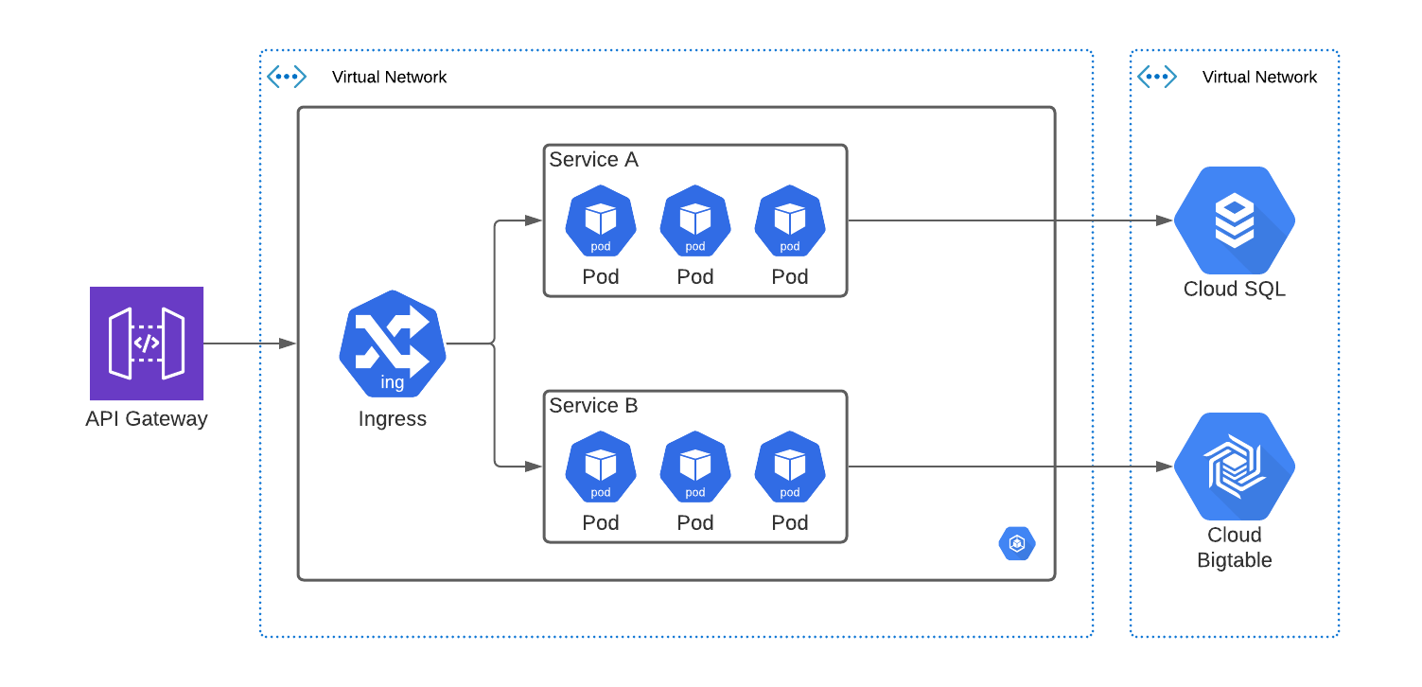
Standard Microservices Deployment

Slide 7
Need of Observability in Microservices
Distributed Systems
Dependency between Microservices
Number of Microservices
Deployment Complexity
Identify latency

Slide 8
Implementing Observability – Change the term
Tracing
Logging
Monitoring

Slide 9
Real World Problems with Microservices
Locating source of issues

Slide 10
Tools for Implementing Tracing
Tracing Libraries
OpenTracing
OpenCensus
OpenTelemetry (OTel)
Spring Cloud Sleuth
Zipkin Instrumentation Libraries
Distributed Tracing Systems
Jaeger
Zipkin
AWS X-Ray
Google CloudTrace
Azure Application Insights
DataDog
Dynatrace
New Relic
Sumo Logic
Honeycomb

Slide 11
OpenTelemetry - OTel
OpenTelemetry is a set of APIs, SDKs, tooling and integrations that are designed for the creation and management of telemetry data such as traces, metrics, and logs
Vendor agnostic
Supports variety of open-source tools such as Jaeger/Zipkin/AWS X-Ray/Google
Future of telemetry instrumentation – gaining lot of support from public cloud platform providers and instrumentation platforms such as Dynatrace/SumoLogic/New Relic

Slide 12
OpenTelemetry Features
A single, vendor-agnostic instrumentation library per language with support for both automatic and manual instrumentation.
A single collector binary that can be deployed in a variety of ways including as an agent or gateway.
An end-to-end implementation to generate, emit, collect, process and export telemetry data.
Full control of your data with the ability to send data to multiple destinations in parallel through configuration.
Open-standard semantic conventions to ensure vendor-agnostic data collection
The ability to support multiple context propagation formats in parallel to assist with migrating as standards evolve.
A path forward no matter where you are on your observability journey. With support for a variety of open-source and commercial protocols, format and context propagation mechanisms as well as providing shims to the OpenTracing and OpenCensus projects, it is easy to adopt OpenTelemetry.
Note – OpenTelemetry is not an observability back-end like Jaeger or Prometheus. Its exports data to variety of open-source and commercial back-ends.
(Ref - What is OpenTelemetry? | OpenTelemetry)

